Slide 1
Money Laundering Prevention

Slide 2
Introduction
- Money laundering disguises illegal funds as legitimate income.
- A global financial crime impacting economic stability.
- Traditional methods struggle with evolving laundering tactics.
- Machine learning provides automated fraud detection capabilities.
- In this project, we built a machine learning-based system to detect suspicious financial transactions and prevent money laundering.

Slide 3
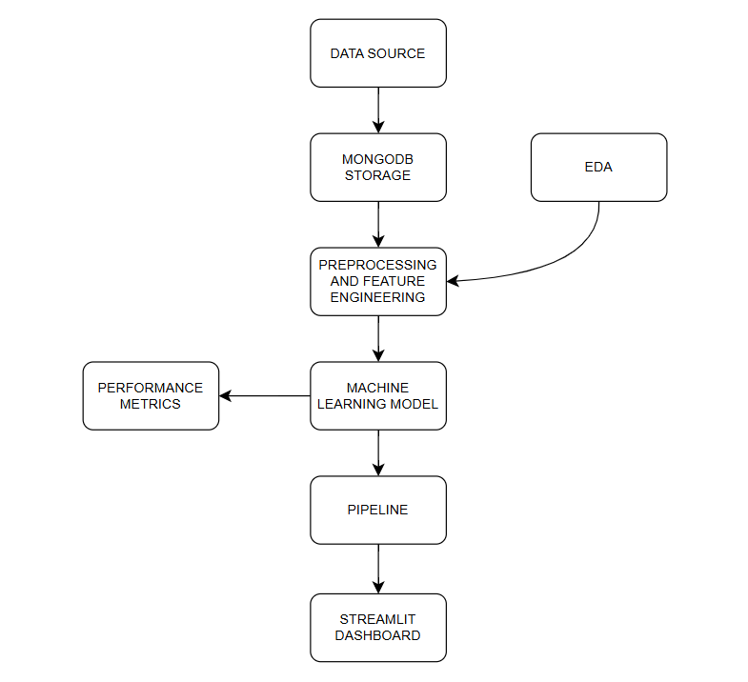

Slide 4
Challenges in Detecting Money Laundering
- Large volumes of financial transactions make manual detection impractical.
- Money laundering strategies constantly evolve, making detection difficult.
- Highly imbalanced data – very few fraudulent cases compared to legitimate transactions.
- Need for real-time monitoring and quick response to prevent illicit activities.
- High false positive rates in traditional rule-based methods lead to inefficiencies.
- Our system addresses these challenges by leveraging machine learning for automated detection.

Slide 5
Role of Machine Learning in AML
- Identifies suspicious transaction patterns using historical data.
- Learns from past fraud cases to detect emerging money laundering techniques.
- Reduces false positives by understanding transaction behaviors.
- Enables real-time monitoring and automated alerts for suspicious activities.
- Helps banks and financial institutions comply with Anti-Money Laundering (AML) regulations.
- Our approach integrates multiple algorithms to enhance detection accuracy.

Slide 6
Data Collection and Preprocessing
- Collected financial transaction data, including attributes like transaction amount, source id, destination id, type of action and fraud level.
- Handled missing values and inconsistencies in the dataset.
- Applied feature engineering to extract key insights such as transaction velocity and account behavior.
- Used data balancing techniques to address the class imbalance problem.
- Normalized numerical data to improve model performance.
- Split the data into training and testing sets for model evaluation.

Slide 7
Algorithms Used for Fraud Detection
- Decision Trees: Simple, interpretable classification model.
- Random Forest: Ensemble method that improves accuracy by combining multiple decision trees.
- Support Vector Machine (SVM): Effective for high-dimensional data and fraud classification.
Naïve Bayes: Probabilistic classifier based on Bayes’ theorem, useful for text-based fraud analysis.
K-Nearest Neighbors (KNN): Non-parametric algorithm that classifies transactions based on similarity to past cases.
- We experimented with different models and tuned hyperparameters for optimal performance.

Slide 8
Model Training and Evaluation
- Trained models on preprocessed transaction data.
- Used cross-validation to avoid overfitting.
- Evaluated models using key performance metrics:
- Accuracy: Measures overall correctness.
- Precision: Percentage of flagged fraud cases that are actual fraud.
- Recall: Percentage of actual fraud cases detected by the model.
- F1 Score: Balance between precision and recall.

Slide 9
Implementation Using Streamlit
- Streamlit is an open-source Python framework for web-based data visualization.
- Built an interactive web application for fraud detection.
- Users can upload transaction datasets and analyze fraud predictions.
- The dashboard provides real-time insights, charts, and tables for AML monitoring.
- Includes options to filter transactions based on risk levels and visualize fraud trends.
- Enables financial analysts to make data-driven decisions efficiently.

Slide 10
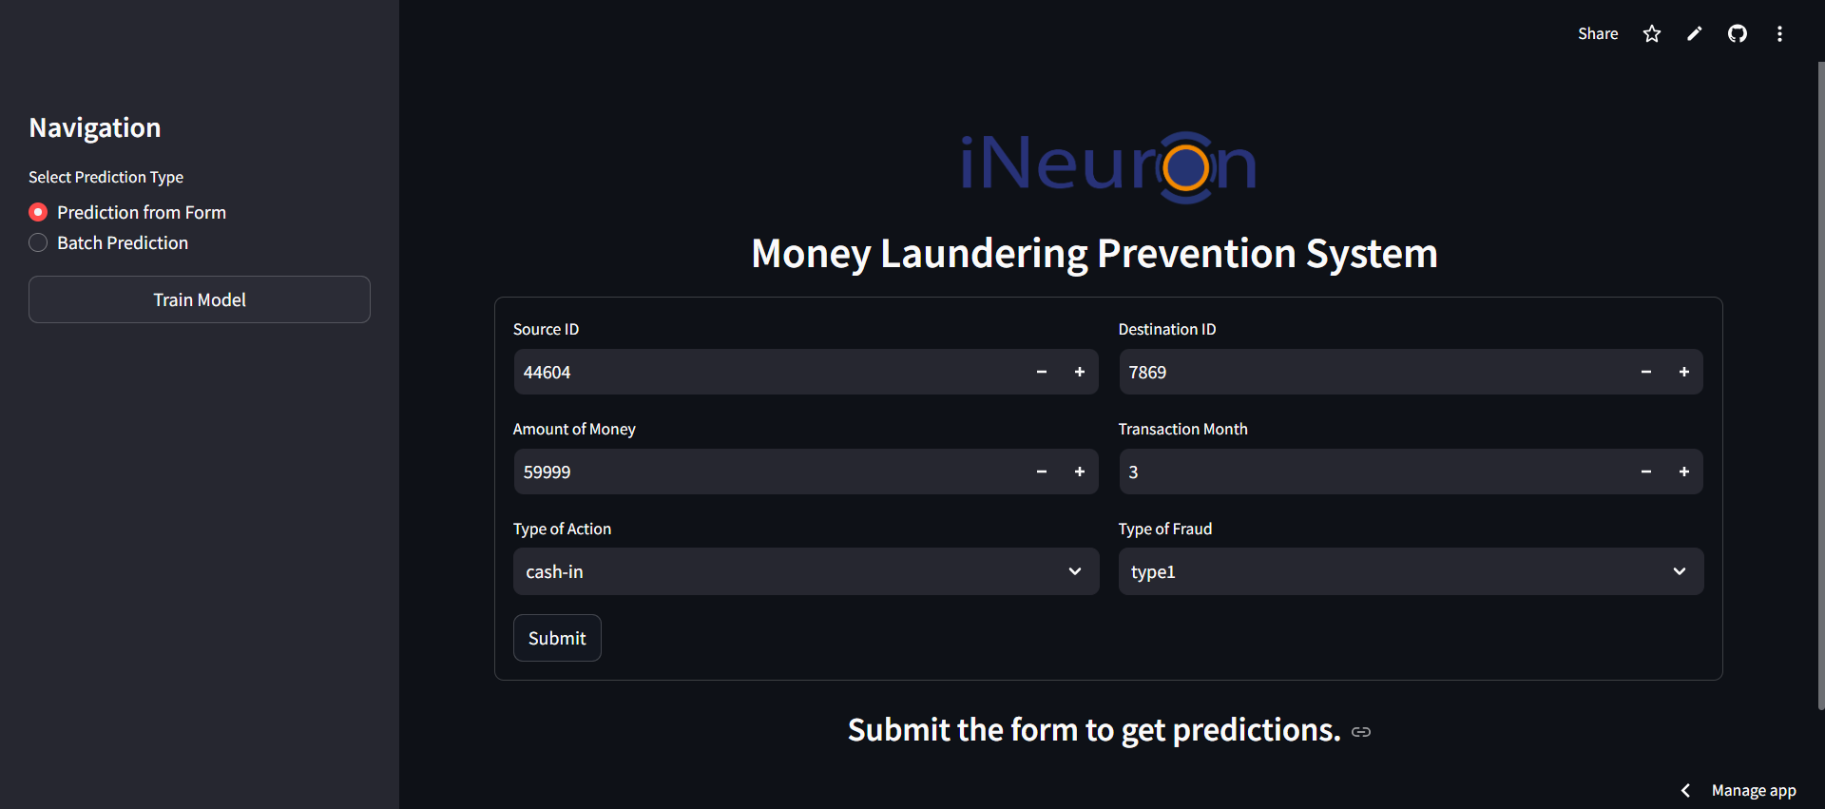

Slide 11
Conclusion
- Money laundering is a major financial crime requiring advanced detection methods.
- Machine learning significantly improves fraud detection accuracy and efficiency.
- We utilized algorithms like Random Forest, Decision Tree, Naïve Bayes, Support Vector Machine and K-Nearest Neighbor to detect fraudulent transactions.
- Performance metrics ensured that our model was both accurate and reliable.
- Streamlit simplified visualization and deployment of AML models.
- Our system provides a scalable and effective solution for financial institutions to combat money laundering.

